Slide 1
Vishal J Lodha PES1UG20CS507
Statistics in Data Science Assignment UE20CS203

Slide 2
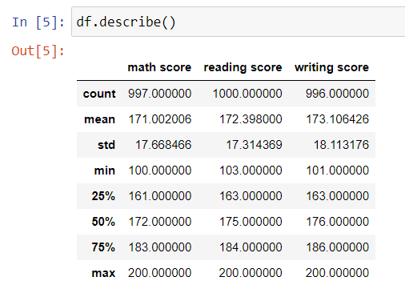
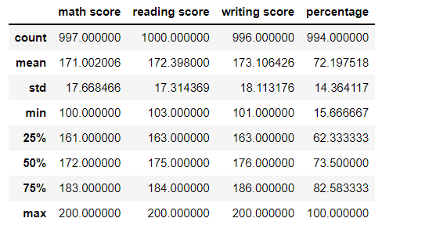
Problem Statement: 1. Add percentage column for the 3 scores
So while describing the data I found out that the marks of students are graded between 100 and 200.
Percentage was calculated then by normalizing marks to 0 and 100 by subtracting 100 marks . Data after adding percentage

Slide 3
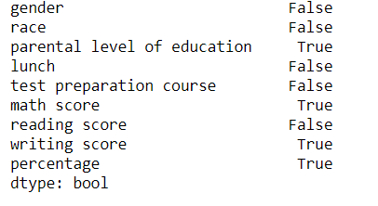
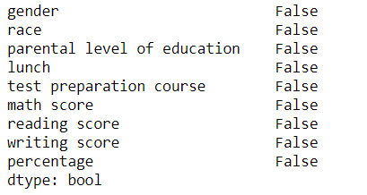
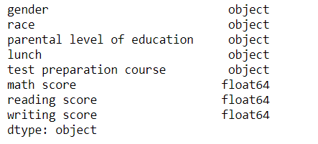
Problem Statement 2.Clear null categorical values and changes numerical values
We 1st found out the types of columns and checked if there were any null values in columns depending upon the type we dropped the data or changed the data values to mean of the entire data set column Before changing values After changing values

Slide 4
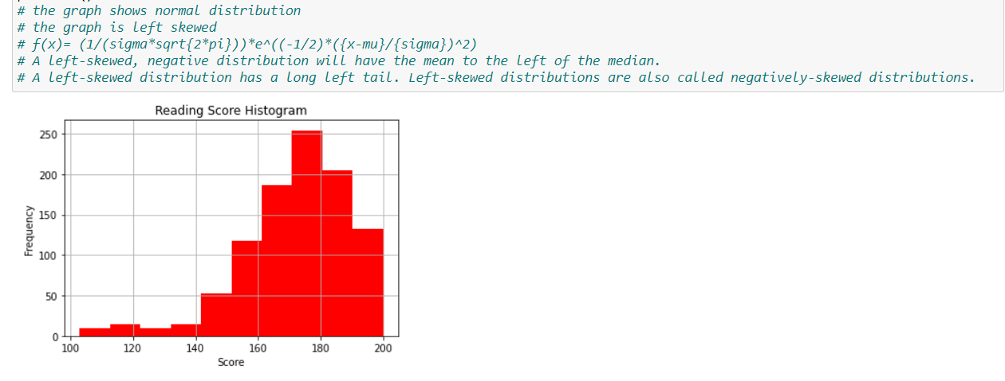
Problem Statement: 3.Visualisation of reading scores and commenting abt the type of distribution
To visualize the reading scores of the data we used a histogram. Seeing the distribution we found that it was a normal left skewed distribution

Slide 5
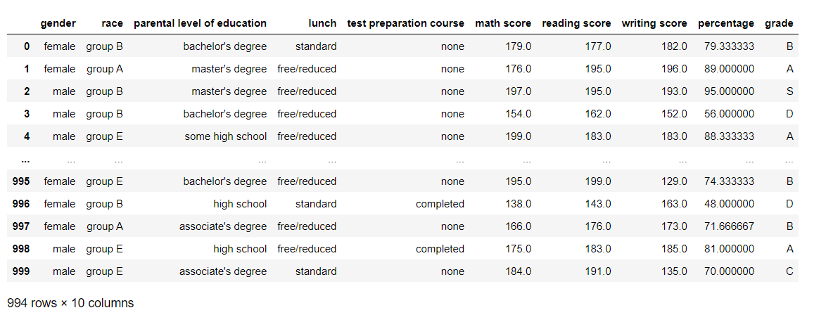
Problem Statement 4.To grade the students based of the percentage they got
To add a column I 1st created a column where I calculated all the grades for each student and then added the list to the dataframe

Slide 6
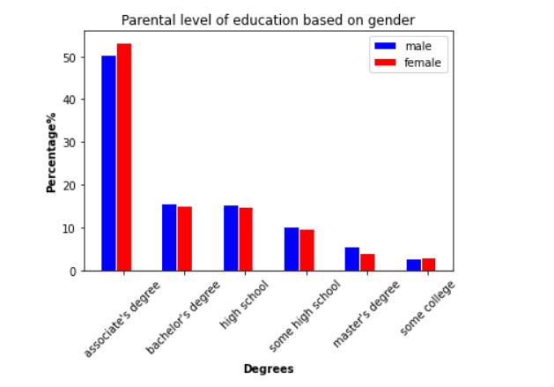
Problem Statement Plotting of a grouped bar chart with parental level for education
I created 2 lists one for men and one for women, now I described that data and found out the percentage on men and women with particular education level after which I plotted the chat

Slide 7
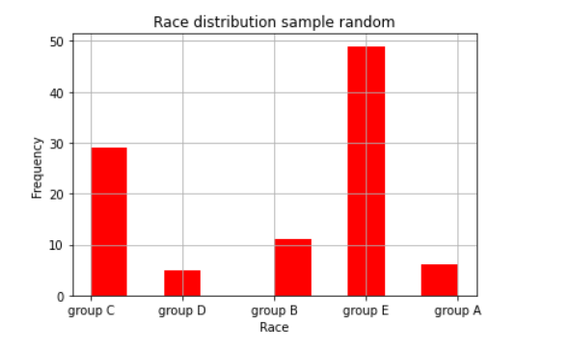
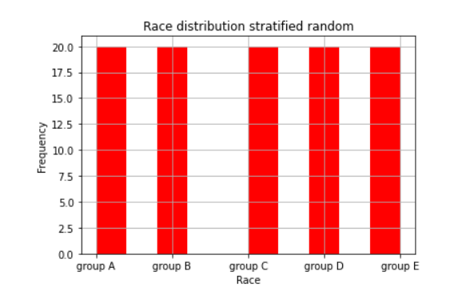
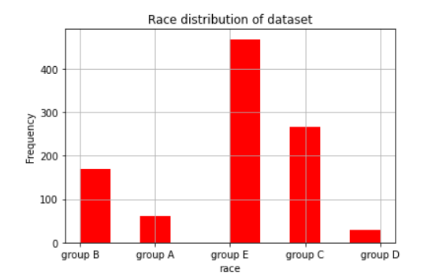
Problem Statement: Plot distribution based on race
we infered that simple random sampling has very random selection from all groups
The stratified sampling gives us 20 ppl from each group thus making it equal spread
the data set sampling shows that there are many ppl from group E and least from group A

Slide 8
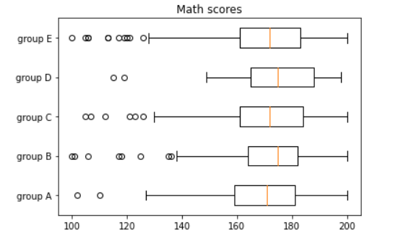
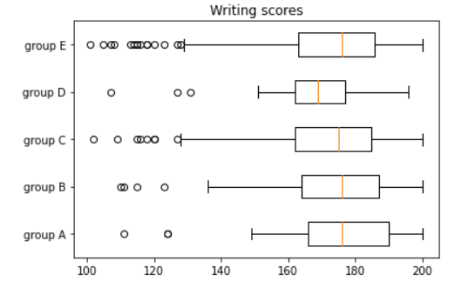
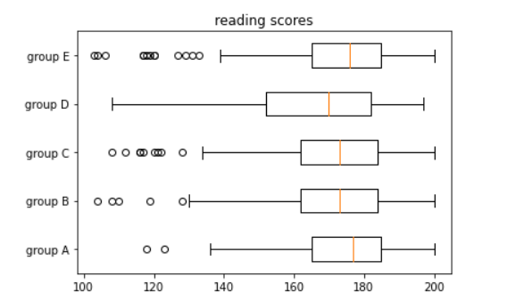
Problem Statement: Box plot of each scores
1st I separated all the different race and then created a box plot such that one plot is on below the other

